Slide 1
Creating a Schoolwide Common Core Math Culture
July 7, 2015

Slide 2
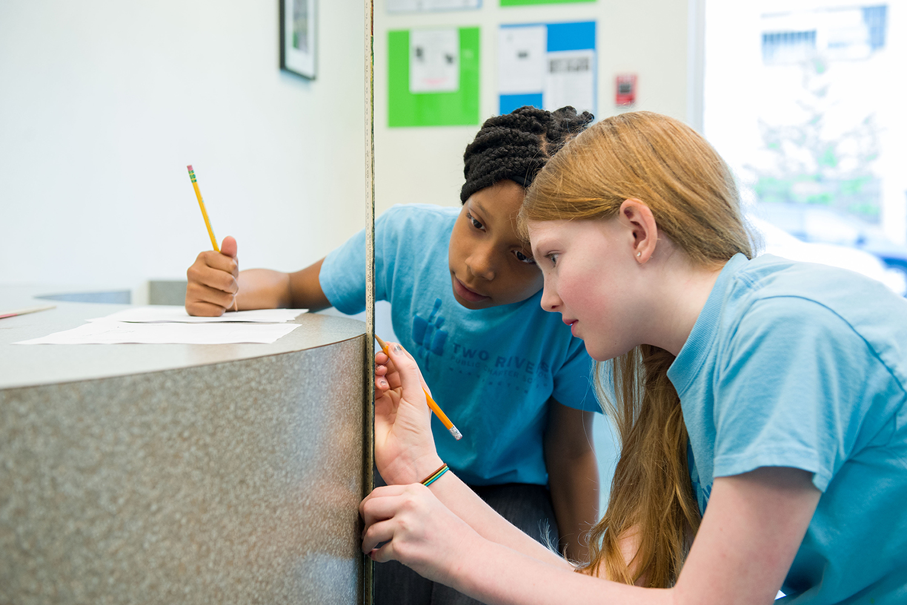
Introductions
Notes:
2 Minutes: : Introduce Two Rivers – PS – 8 etc.
Caroline

Slide 3
Learning Targets
I will describe my own school culture around math.
I will be able to outline the steps that Two Rivers took to shift their school culture around math.
I will identify at least one key step that I will take back to improve the culture of math at my school.
Notes:
3 Minutes: Caroline

Slide 4
Writing Your School’s Math Story
Take 5 minutes to describe the math culture of your school
Fill out the template to describe your school’s math culture.
Consider specific conversations that you have had with students, staff, and families or events that exemplify your description of the culture of math in your school.
Notes:
Jeff
7 minutes

Slide 5
Share Your School’s Math Story
Notes:
2 Minutes - Jeff – Find partner not from your school and share your school culture story.
SHARE – Were there similarities or difference – big themes

Slide 6
TWO RIVERS MATH STORY
Notes:
Jeff

Slide 7
Two Rivers Culture of Math Circa 2010
Strong Professional Culture
6-Year History as an Expeditionary Learning School
Focus on data-analysis as a tool for instructional improvement
Use of data from MAP Assessment (Norm-Referenced Data) and Achievement Network (Criteria-Referenced Data) in Math
General dislike of mathematics
Mathematics scores that continued to lag behind reading scores.
Notes:
Jeff

Slide 8
CHELSIE’s Math Story: Before Two Rivers

Slide 9
Staff Affective Response Experience with Math as Reported in Math Stories August 2010
Notes:
Jeff

Slide 10
“ …teachers – like all other adults in this country – are graduates of the system we seek to improve.”
- Deborah Loewenberg Ball in Mathematics in the 21st Century: What Mathematical Knowledge is Needed for Teaching Mathematics?
Notes:
Jeff -

Slide 11
Two Rivers DC-CAS Proficiency Percentage, 2006-2010
Notes:
Jeff

Slide 12
What does our data NOT tell us?
To nurture a diverse group of students to become lifelong, active participants in their own education, develop a sense of self and community, and become responsible & compassionate members of society.
Discrete skills in math and reading – multiplication, math problem solving, vocabulary, reading comprehension.
Two Rivers Mission
What Standardized Tests Assess
Notes:
Jeff

Slide 13
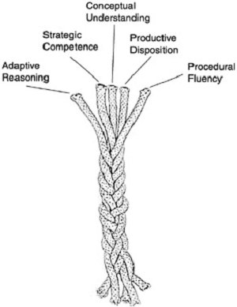
Intertwined Strands of Proficiency from Adding + It Up: Helping Children Learn Mathematics (2001) from the National Research Council
Notes:
Jeff

Slide 14
Expanded Learning Outcomes
A shift is occurring in the outcomes that we recognize for mathematics learning
Common Core State Standards
Fewer standards per grade level
Greater emphasis on the depth of the standards pointing to conceptual understanding and strategic competency in addition to procedural fluency
Inclusion of mathematical practices
Notes:
Jeff

Slide 15
We select an instructional focus that helps our community realize our mission of deeper learning for all.
There should only be one adaptive thing that the organization is working on and we should be working on it together.
The focus should be rooted in data about student needs, grounded in theory and research, and nurtured by the leadership team.
Our schedule, structures, time, and attention should all reflect what we value as expressed through our instructional focus.
Notes:
Caroline – Focusing on ONE THING

Slide 16
Three Year Arc of Culture Change
Year 1: Building Staff Capacity in Math and A Culture of Mathematical Literacy
Year 2: Developing Unit Plans of Instruction
Year 3: Developing Daily Problem-Based Task Lessons
Notes:
Caroline - Talk about graphic organizer – The Connect – Extend – Challenge – CHANGE TAKES TIME

Slide 17
Year 1: Building Staff Capacity in Math and A Culture of Mathematical Literacy
2010 - 2011
Notes:
Jeff
10 minutes

Slide 18
“Improving the mathematics learning of every child depends on making central the learning opportunities of our teachers.”
- from Deborah Loewenberg Ball, Mathematics in the 21st Century: What Mathematical Knowledge is Needed for Teaching Mathematics?
Notes:
Jeff

Slide 19
Year 1: Building Staff Capacity in Math and A Culture of Mathematical Literacy
Staff Created Math Stories
7 Three Hour Sessions During the Course of the Year to Develop Staff Conceptual Understanding of Math
Culminating in Collaborative Geometry Project for Art Sold at our Fundraising Gala
Review of the elementary text book series Everyday Math and exploration of other options
Shift from Math Information Night for Parents to Math Festival
Mathemagical Wizardry Prize
Notes:
Jeff

Slide 20
Math Sessions
During Orientation: Math Stories
September 29: Exploration of Real Numbers
October 20: Exploration of Elementary Operations
November 10: Exploration of Rational Numbers
February 23: Exploration of Geometry Concepts
March 2: Creation of Geometry Art
March 23: Revisiting Our Math Stories
Notes:
Jeff- These sessions were intended to deepen conceptual understanding of math as well as an appreciation of mathematics and how it can be taught. The sessions did not have an intended direct impact on changing teacher practice in the classroom the next day – it was a about culture shift

Slide 21
Two Rivers Interactive Geometry Art: Pentominoes
Notes:
Jeff- Why are we spending so much time doing math and art? What a waste of my time! As a 1st year teacher at TR deeply disturbed that we had to spend all of this time doing math and art…

Slide 22
Tiling the Plane
Notes:
Jeff

Slide 23
Perspective and the Two Rivers Logo
Notes:
Jeff – I had to be a learner again… Embracing role of a learner

Slide 24
COMMON MATH EXPECTATIONS
We believe math is fun: Time is built into lessons to play with math.
We believe all students can learn math: Every student has the capacity to learn deeper conceptual knowledge in mathematics.
We value a common approach to problem solving: We use the K-W-I to teach steps to problem solving in and outside of math.
We value multiple representations: We value the multiple ways that ideas can be modeled or demonstrated and encourage making connections between various representations.
We value concise and precise communication: We reinforce precision and brevity during class discussion.
We value reasoning and proof: Mathematical arguments are weighed on the merits of their logic NOT on the status of the speaker or beauty of the language.
Notes:
Jeff - 1. No one deprecates math. Or dismisses it with comments like I was never good at math / I’m just not a math person. You don’t really need this stuff anyway
3. Include a comment about teaching heuristics to solving novel tasks

Slide 25
CHELSIE’s Math Story: AT Two Rivers

Slide 26
Connect – Extend – Challenge: Year 1
What CONNECTS to what you already know about your school’s math culture?
How does what Two Rivers did EXTEND your thinking about your school’s math culture?
How does Two Rivers story CHALLENGE your thinking about your school’s math story?
Notes:
Helen

Slide 27
Year 2: Developing Unit Plans of Instruction
2011 - 2012
Notes:
Jeff

Slide 28
Maths in the CITY
Notes:
Jeff

Slide 29
Maths in the City
Launch of the year during staff orientation.
Develop connections with at least three other colleagues by working collaboratively to solve an ill-structured problem.
Build understanding and appreciation of mathematics in Washington DC
Develop an understanding of how a project can be used to drive an understanding of math content
Notes:
Jeff

Slide 30
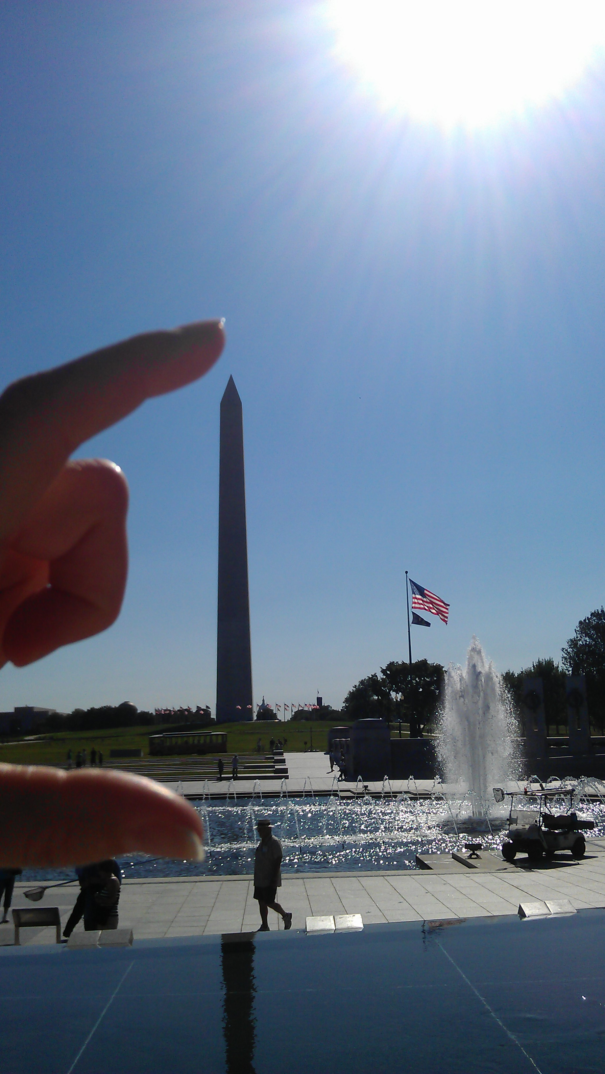
Measuring the Monument
Notes:
Jeff

Slide 31
Year 2: Developing Unit Plans of Instruction
Adopted a New Elementary Math Text Book Series: EnVision Math
Professional Development Focusing on:
Unit Planning in Math
Assessing Process Standards
Flexible Groups
Using Critique Protocols
Continuation of Mathemagical Wizardry Prize
Notes:
Caroline- EnVision afforded us two key aspects – Non-spiraling curriculum and tools for practicing basic skills and knowledge to free teachers to plan problem-based tasks
Unit Planning Applied Lessons from Problems as Possibilities to Math Class

Slide 32
Problem-Based Tasks
“Most, if not all, important mathematics concepts and procedures can best be taught through problem solving.”
- John Van de Walle
Teaching Student-Centered Mathematics
Notes:
Caroline - Pulling out the rug – Teacher as designer of curriculum

Slide 33
Arc of Problem-Based Units
KWI
Individual Lessons & Formative Assessment
Introduce the Problem
KWI
Individual Lessons & Formative Assessment
KWI
Problem Check-in
Solve the Problem
Summative Assessment
Notes:
Caroline

Slide 34
Differentiated Assignments
Assessment
Assignment for Flexible Group 1: Builds Factual Knowledge that relates back to core concepts
Assignment for Flexible Group 3: Expands Conceptual Knowledge
Assignment for Flexible Group 2: Builds Conceptual Knowledge by building on Factual Knowledge
Product for investigation that applies conceptual knowledge to solving the problem at the heart of your expedition
Notes:
Caroline

Slide 35
Connect – Extend – Challenge: Year 2
What CONNECTS to what you already know about your school’s math culture?
How does what Two Rivers did EXTEND your thinking about your school’s math culture?
How does Two Rivers story CHALLENGE your thinking about your school’s math story?
Notes:
JHW

Slide 36
Year 3: Developing Daily Problem-Based Task Lessons
2012 - 2013
Notes:
Jeff

Slide 37
Year 3: Developing Daily Problem-Based Task Lessons
Professional Development Focusing on:
Daily Problem-Based Task Lesson Plans
Utilizing Share and Debrief for Students to Synthesize Understanding
Math Coffee with Parents
Notes:
Jeff- Unit Plans bombed – We learned from failure

Slide 38
Problem-Based Lesson
BEFORE PROBLEM SOLVING
Introduce the Problem: The problem is presented to students with little or no direction about skills and knowledge to apply
DURING PROBLEM SOLVING
Independent Work: Students use previous knowledge and intuition to develop skills to grapple with the concepts and to solve the problem
AFTER PROBLEM SOLVING
Share and Debrief: Students share their work and make meaning of their work and learning
Notes:
Jeff: Note that this is the 5 E’s Engage, Explore, Explain, Extend, Evaluate: Problem-Based Lesson synomous with inquiry-based lesson- Workshop 2.0
Jes: Daily Means daily; providing the teachers with the tools and times to be designers – common planning time

Slide 39
Steps to Planning Designing A Problem-Based Task
Begin with the math!
Think about your students.
Decide on a task
Predict what will happen.
Articulate student responsibilities.
Plan the elements of the lesson.
Notes:
Backwards planning
– common planning time – give teachers the resources to do this.

Slide 40
Problem-Based Task in Middle School
Students model a dive from a diving board using a quadratic equation to measure height above the water over time.

Slide 41
Connect – Extend – Challenge: Year 3
What CONNECTS to what you already know about your school’s math culture?
How does what Two Rivers did EXTEND your thinking about your school’s math culture?
How does Two Rivers story CHALLENGE your thinking about your school’s math story?
Notes:
Jeff

Slide 42
Two Rivers Today
Notes:
MB: continuing the work from the previous years and working this year to formalize and archive unit plans as we move to replicate in 2015

Slide 43
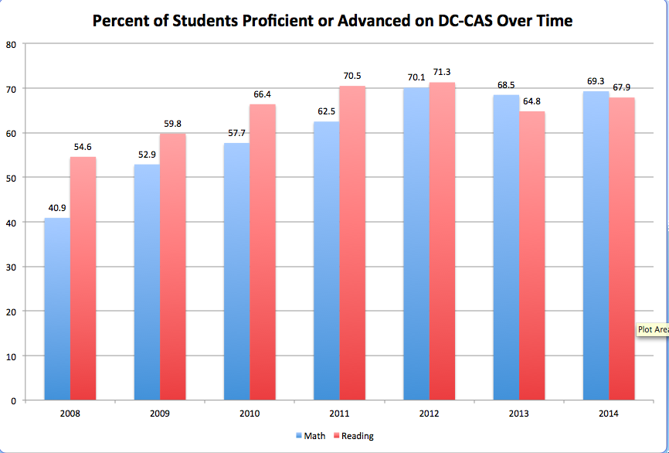
Notes:
Caroline

Slide 44
DC-CAS 2013 and 2014 Successes
Students who were at Two Rivers from 2011-2014 increased in proficiency:
In Math, from 60.75% proficient or advanced in 2011 to 82.24% proficient or advanced in 2014, an increase of 21.49 percentage points.
Notes:
Caroline

Slide 45
DC-CAS 2013 and 2014 Successes
The number of kids who have been at Two Rivers 3+ years scoring advanced in last year’s math is five times the number of students at TR 1-2 years scoring advanced.
Notes:
Caroline

Slide 46
DC-CAS 2013 and 2014 Successes
Of the cohort of African-American students who attended Two Rivers from 11/12 to 13/14, they grew from:
49.35% to 76.62% proficient/advanced in math
In math, TR African-American 8th graders scored 88.6% proficient or advanced, compared to the city average of 62.7%.
African-American 8th graders at Two Rivers performed 25-33 percentage points higher than the average for that grade and subgroup in the city in 2014.
Notes:
Caroline

Slide 47
DC-CAS 2013 and 2014 Successes
Of the cohort of students who qualify for free or reduced price lunch who attended Two Rivers from 11/12 to 13/14, they grew from:
49.12% to 77.19% proficient/advanced in math
Notes:
Caroline

Slide 48
Three Year Arc of Culture Change
Year 1: Building Staff Capacity in Math and A Culture of Mathematical Literacy
Year 2: Developing Unit Plans of Instruction
Year 3: Developing Daily Problem-Based Task Lessons
Notes:
Jeff

Slide 49
Synthesis
What did you connect with in our story?
What in our story extends your thinking about how to shift a school’s culture around math?
What challenges your thinking?
Notes:
Jeff – Silent Reflection

Slide 50
What Step Will You Take Back to Your School
After the presentation, what action do you feel like would be a reasonable step for you to take to shift the culture of math at your school in a positive direction?
Notes:
Jeff - Sharing

Slide 51
Questions
Jeff Heyck-Williams
EMAIL: jheyckwilliams@tworiverspcs.org
TWITTER: @jheyckwilliams
Caroline Mwendwa-Baker
EMAIL: cbaker@tworiverspcs.org
TWITTER: @mwbakerc
Two Rivers Public Charter School
WEB: www.tworiverspcs.org
TWITTER: @TwoRiversPCS
#LearningandLovingMath

