Slide 1
Using Data to Find the Best Fit for College and Ensure College Retention
Presenters:
Sanjay Mitchell, Director of College and Alumni Programs
Emma Levine, Alumni Program Manager/College Counselor
Thurgood Marshall Academy

Slide 2
Workshop Takeaways
Strategies in Collecting and Analyzing Data to Increase College Enrollment Rates
Strategies in Collecting and Analyzing Data to Increase College Retention Rates
How to Use Tools such as Naviance and National Student Clearinghouse
Using Data to best Counsel Students on Best College Fit

Slide 3
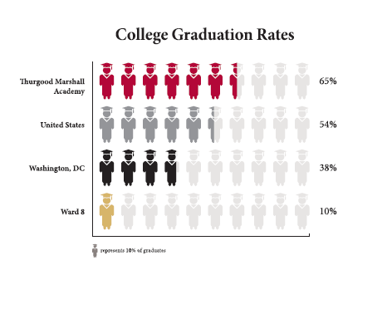
College Success

Slide 4
Gathering Information: How, When & Why
What | How | When | Why
Transcript (static) | SIS (Blackbaud) | Real-time | Mail to colleges; college guidance; error check
SAT** | College Board/ ED | On-going | College guidance; ensure student has score
PSAT | College Board /ED | December | Discrepancy between PSAT and SAT/ACT
ACT | ACT | On-going | College guidance; ensure student has score
AP** | College Board (electronic score download)/ ED | 1st week of July | College guidance
IB | n/a | n/a | College guidance
TANF/SNAP/ Financial | SLED – (citywide data system used for enrollment) | September; real-time | College guidance; fee waivers
Progress Reports & quarterly report cards (Senior year- fluid) | SIS (Blackbaud) | Real-time | Admission for college; negotiation with college admission counselor; summer program eligibility; fly-in programs
Task: Identify Internal Gatekeepers and Time Sequence
Who is the keeper of data and information for the student population. How can you access this data to gather the necessary information needed to begin counseling students on the college application process.
2. At what point in the process is it necessary to secure this data for students.

Slide 5
SLED: Statewide Longitudinal Education Data System
Task: Identify External Data to Support College Application Process
Get access to SLED – or your student Statewide Data System
Gather information about your most sensitive and neediest students to support during the college application process

Slide 6
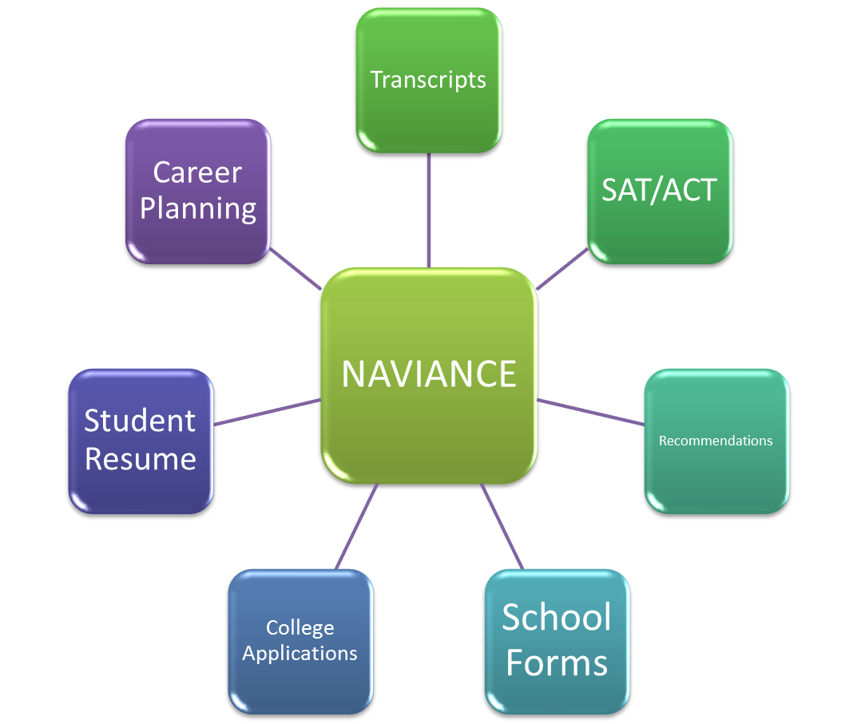
Information Management: Naviance
Task: Create a Counseling Data Management System
Secure Naviance or other type of college Data Management System
Get access to ALL features and support tabs so as to expedite the process for students and make your life easier

Slide 7
Information Management: Naviance
What | How | When | Why
Transcript | PDF file upload for each student | Real-time | Mail to colleges; college guidance
SAT & ACT data | CSV file upload | On-going | College guidance; send to colleges
Recommendations | Uploaded by Teachers/Staff | Late October – December | Mail to colleges or scholarship organizations
School Forms | Pre-populated forms filled out by counselor | September – March | Mail to colleges along with transcript
College Applications | Linked with Common App and Electronic submission; Students upload college list | October – January | College guidance
Student Resume | Created by students | October | Submit with college materials
Myers Briggs & Learning Style Inventory | Administered during Advisory | 2nd semester Freshman and Junior years | College guidance; assist teachers with understanding students’ learning style
Career Planning | Administered during Advisory or other college related activities | On-Going | Students can begin thinking about careers; Used to drive major choices and help with college guidance

Slide 8
College Enrollment Data
Type of Institution Enrolled, by Class
How this Data Shapes Programming
Ensure DCTAG application
Ensure all college options discussed with students
Check in with students during summer before college enrollment

Slide 9
SAT Data
How this Data Shapes Programming
Strengthen SAT curriculum
In-school SAT testing
Ensure registration for AP and SAT is easy and accessible to ensure higher participation

Slide 10
Other Enrollment Data
Financial Aid Received
Break down of type of financial aid: institutional, private, FAFSA
List of scholarships each year to maintain partnerships and guide students on scholarships to which they should apply

Slide 11
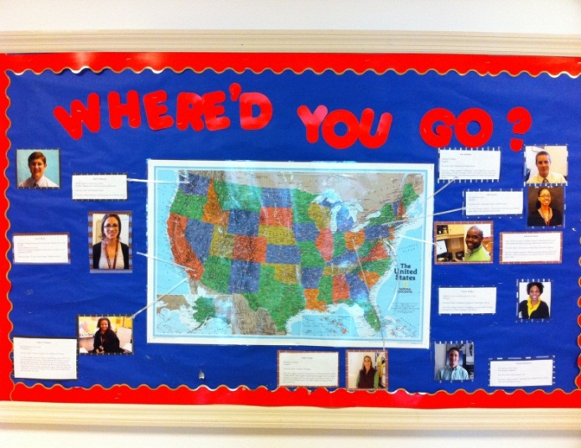
How to Collect Retention Data
National Student Clearinghouse
Alumni Association for each class (incentivize students)
Using resources in building or community to track students
Alumni Surveys (through newsletters, social events)
College visits
Naviance

Slide 12
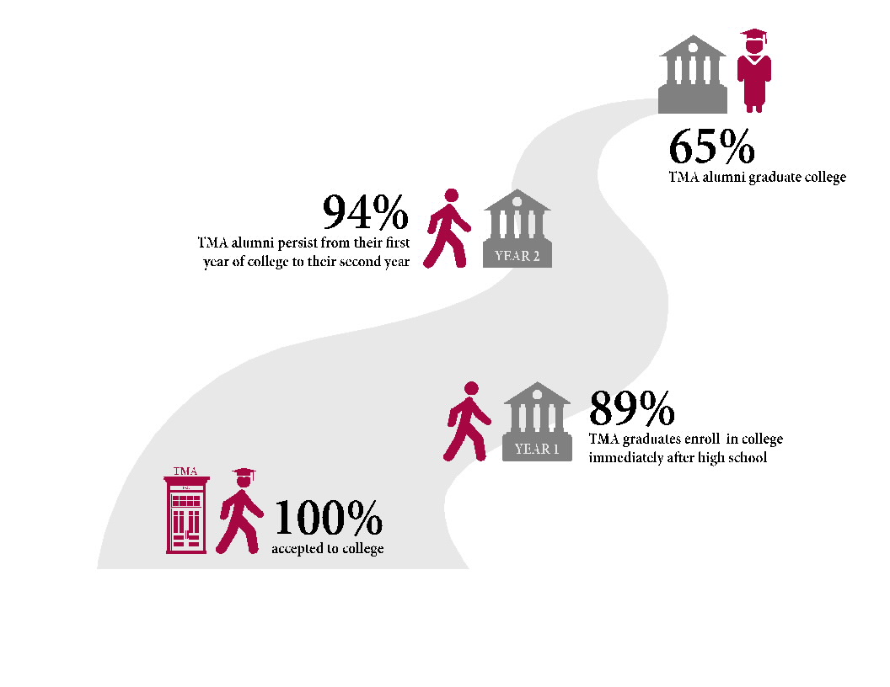
Retention Data
Why is this data important?
What does it tell us?

Slide 13
How Retention Data Shapes Programming
Ensuring Best College Fit
Which colleges are students most likely to graduate
Which colleges provide 100% financial aid
Alumni Counseling
Which students will need most support or least support
Check in with students if attending community colleges for transfer help

Slide 14
Other Helpful Retention Data
Percentage who transfer from community college to 4-year college
Percentage who transfer from 4-year college to community college
Percentage who pursue military or apprenticeship programs
Qualitative data as to WHY students drop out
Allows Counseling Office to provide more options, opportunities to students, and a holistic approach
Counseling Office can better counsel students with similar academic profiles and ensure best college fit

Slide 15
Data Collection Challenges
Academic remediation in college– what percentage enroll in remedial courses
Common majors in college
Graduate level coursework
Professional experiences after college

Slide 16
Questions?

