Slide 1
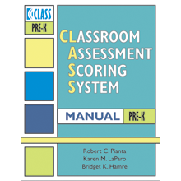
Using the CLASS tool to Improve Instructional Practices in Early Childhood
Tracie Dow and Felicia Owo

Slide 2
Agenda
Welcome
Overview of CLASS
Analyzing CLASS data
Lesson planning with the CLASS tool

Slide 3
Objectives
Participants will…
Analyze CLASS data in order to identify the highest leverage action(s) that will improve student learning
Utilize CLASS guiding questions to plan for instruction
Notes:
for a component of the school day
Create small group/center time plans that increase quality interactions, i.e., higher order thinking questions, conceptual learning activities

Slide 4
Getting to Know You
Rate your knowledge of the CLASS tool:
1 – I have heard about the CLASS tool
2 – I have been observed with the CLASS tool
3 – I have been trained on the CLASS tool
4 – I use the CLASS tool to lesson plan, coach, or evaluate teachers

Slide 5
Getting to Know You
What is your role?
1 – Teacher
2 – Instructional Coach
3 – Administrator

Slide 6
Overview of the CLASS Tool

Slide 7
What is the CLASS?
The Classroom Assessment Scoring System© (CLASS) is a research-based observation tool used to help teachers and schools improve the quality
of classroom interactions.
Notes:
Additional thoughts:
The CLASS was developed by a team of researchers at the University of Virginia with the purpose of assessing classroom quality.
It helps observers structure observations by providing a common lens for observing classrooms (the CLASS lens).
The CLASS also provides a common language when discussing effective teaching.

Slide 8
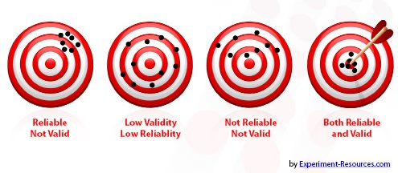
A Research-Proven Measure
Created and studied by researches at the University of Virginia, the CLASS measure is
Reliable – Trained observers will see the same things across different settings.
Valid – CLASS scores reflect the interactions that matter for students’ social and academic development.
Notes:
Columbia University research on validity

Slide 9
What is the CLASS?
CLASS observations are conducted in 6 cycles.
A cycle consists of:
one 20-minute observation period
one 10-minute recording period
Notes:
Total of 120 minutes – CLASS Reliable Trainers hired by the DCPCS and school administrator & Instructional coaches

Slide 10
What is the CLASS?
CLASS measures:
The quality of classroom interaction processes
The overall classroom experience based on all adult and child participants

Slide 11
Organization of the CLASS instrument
Classroom Quality
DOMAINS
Emotional
Support
Classroom Organization
Instructional Support
Notes:
The CLASS focuses on three broad domains of effective interactions that characterize children’s classroom experiences.
Each domain is comprised of multiple dimensions of effective interactions known to contribute to children’s success in school … we will look at each domain in detail in later slides.

Slide 12
CLASS-AT-A-GLANCE
Domains
Emotional
Support
Classroom Organization
Instructional Support
Positive relationships among teachers and children, teachers’ abilities to support social and emotional functioning in the classroom
Well-managed classrooms that provide children with frequent, engaging learning activities
Interactions that teach children to think, provide ongoing feedback and support, and facilitate language development
Each domain includes Dimensions, Indicators and Behavioral Markers
that focus on various aspects of adult-child interactions.
Notes:
The CLASS focuses on three broad domains of effective interactions that characterize children’s classroom experiences.
At the broadest level there are three domains that contribute to the CLASS definition of classroom quality: Emotional, Organizational, and Instructional Support.

Slide 13
CLASS-AT-A-GLANCE
EMOTIONAL SUPPORT
Positive Climate (4 Indicators)
CLASSROOM ORGANIZATION
Behavior Management (4 indicators)
INSTRUCTIONAL SUPPORT
Concept Development (4 indicators)
Quality of Feedback (5 indicators)
Regard for Student Perspectives (4 indicators)
Teacher Sensitivity (4 indicators)
Negative Climate (4 indicators)
Productivity (4indicators)
Instructional Learning Formats (4 indicators)
Language Modeling (5 indicators)
Notes:
Give participants a few moments to check their group work

Slide 14
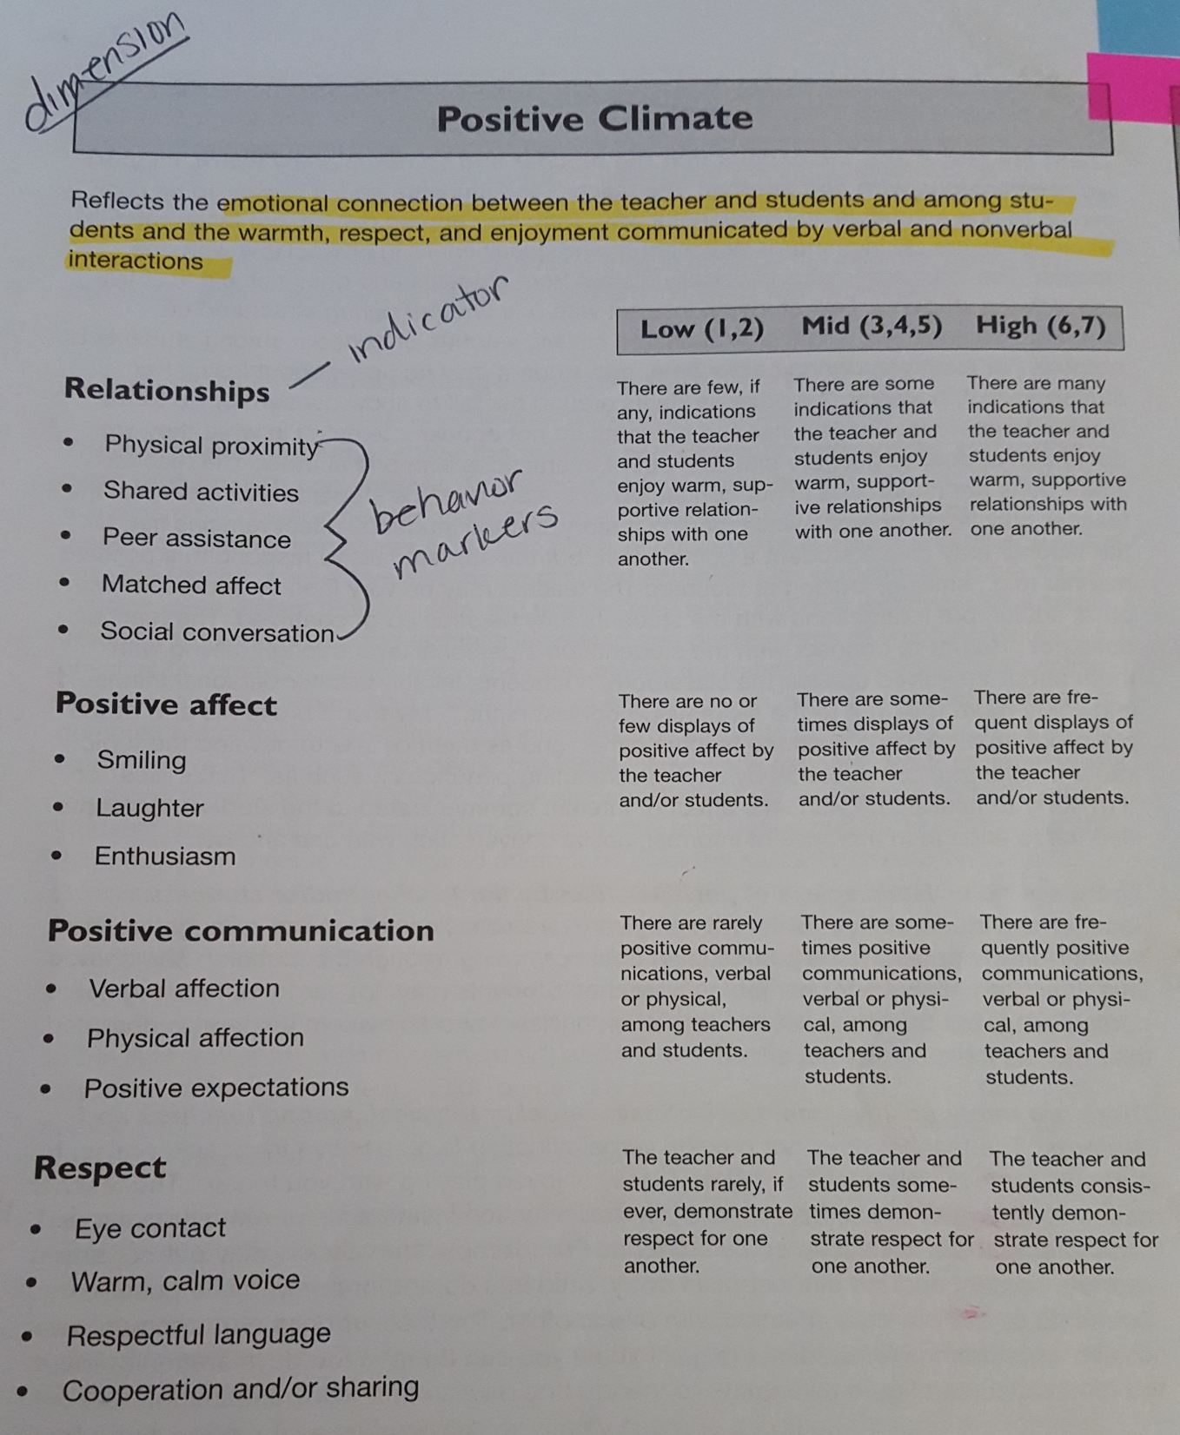
Example
Domain: Emotional Support
Dimension: Positive Climate

Slide 15
EMOTIONAL SUPPORT
DIMENSIONS
Positive Climate
Regard for Student Perspectives
Teacher Sensitivity
Negative Climate
How teachers help students develop:
Warm, supportive relationships with teachers and peers
Enjoyment of and excitement about learning
Feelings of comfort in the classroom
Appropriate levels of autonomy
Notes:
Review each of the dimensions and ask participants to follow along in their Dimensions Guide:
Positive Climate
The emotional tone of the classroom and the connection between teachers and students.
Negative Climate
The absence of Positive Climate.
Teacher Sensitivity
Awareness of and responsivity to students’ academic and emotional concerns.
Regard for Student Perspectives
The degree to which teachers’ interactions with students and classroom activities place an emphasis on students’ interests, motivations, and points of view.

Slide 16
CLASSROOM ORGANIZATION
DIMENSIONS
Behavior Management
Productivity
Instructional Learning Formats
How teachers help students:
Develop skills to help them regulate their own behavior
Get the most out of each school day
Maintain interest in learning activities
Notes:
Review each of the dimensions and ask participants to follow along in their Dimensions Guide:
Behavior Management
Teachers ability to use effective methods to prevent and redirect misbehavior.
Productivity
Teachers’ ability to manage instructional time and routines to maximize time for learning.
Instructional Learning Formats
How teachers facilitate activities and provide interesting materials so that students are engaged and learning opportunities are maximized.

Slide 17
INSTRUCTIONAL SUPPORT
DIMENSIONS
Concept Development
Quality of Feedback
Language Modeling
How teachers help students:
Learn to solve problems and think creatively
Get individualized feedback about their learning
Develop more complex language
Notes:
Review each of the dimensions and ask participants to follow along in their Dimensions Guide:
Concept Development
How teachers promote students’ higher-order thinking skills in contrast to a focus on rote instruction.
Quality of Feedback
How teachers extend students’ learning through their responses to students’ ideas, comments, and work.
Language Modeling
The extent to which teachers facilitate and encourage students’ language.

Slide 18
WHAT DOES THIS LOOK IN THE CLASSROOM?
EMOTIONAL SUPPORT
Close Proximity to students
CLASSROOM ORGANIZATION
Students are reminded of behavior expectations
INSTRUCTIONAL SUPPORT
Connections are made to student lives
Feedback loops and exchanges are consistent
Aware of student needs
Regular Positive Communication
Matched Affect
Materials are prepared and ready for activity
Students are aware of routines; Transitions are quick
Frequent conversation
Notes:
CLASS-AT-A-GLANCE ACTIVITY SHEET
In groups, have participants work together (for 5-7 minutes) to decide which of the descriptions fit within each of the Domains

Slide 19
CLASS Domains & Dimensions
EMOTIONAL SUPPORT
Positive Climate (4 Indicators)
CLASSROOM ORGANIZATION
Behavior Management (4 indicators)
INSTRUCTIONAL SUPPORT
Concept Development (4 indicators)
Quality of Feedback (5 indicators)
Regard for Student Perspectives (4 indicators)
Teacher Sensitivity (4 indicators)
Negative Climate (4 indicators)
Productivity (4indicators)
Instructional Learning Formats (4 indicators)
Language Modeling (5 indicators)
Notes:
Give participants a few moments to check their group work

Slide 20
Analyzing CLASS Data

Slide 21
Teacher A Data
 | Classroom Averages | Threshold for Quality
Emotional Support | 5.92 | 5
Positive Climate | 6.17
Negative Climate | 1.00
Teacher Sensitivity | 5.83
Regard for Student Perspectives | 4.67
Classroom Organization | 5.17 | 5
Behavior Management | 5.17
Productivity | 6.00
Instructional Learning Formats | 4.33
Instructional Support | 2.22 | 3
Concept Development | 2.17
Quality of Feedback | 2.33
Language Modeling | 2.17

Slide 22
Analysis: Perspectives
Goal: Determine the highest leverage focus area
As a teacher, where would you want to push yourself if this was your data?
As a coach or administrator, where would you want to push your teacher?

Slide 23
Analysis: Guiding Questions
Goal: Determine the highest leverage focus area
Areas of Strength?
Areas of Growth?
What patterns do you notice?
What confirms what we already knew?
What challenges what we thought?
What conclusions can be drawn?

Slide 24
Analyzing your Data Guiding Questions
Goal: Determine the highest leverage focus area
Areas of Strength?
Areas of Growth?
What patterns do you notice?
What confirms what we already knew?
What challenges what we thought?
What conclusions can be drawn?

Slide 25
PRACTICE!

Slide 26
Data Analysis Reflections
Why is it important to analyze CLASS data?
What did you find the most challenging?
What were your biggest takeaways?

Slide 27
Lesson Planning

Slide 28
Guiding Questions for Lesson Planning

Slide 29
Objectives Recap
Participants will…
Analyze CLASS data in order to identify the highest leverage action(s) that will improve student learning
Utilize CLASS guiding questions to plan for instruction
Notes:
for a component of the school day
Create small group/center time plans that increase quality interactions, i.e., higher order thinking questions, conceptual learning activities

Slide 30
CLOSING
Reflection
Evaluation

