Slide 1
Using PivotTables to Answer Questions About Students
July 2015

Slide 2
Session Outcomes
By the end of this session, participants will be able to:
Articulate 2-3 types of analyses that can be completed using PivotTables
Use PivotTables to complete 2-3 types of analyses
Communicate the process of investigating priority questions using PivotTables
Notes:
1

Slide 3
Overview
What is a PivotTable?
An excel tool for analyzing a spreadsheet of data
What types of analyses are possible using PivotTables?
Counting things (total students in a class)
Percentages of things (percent of females in a school)
Averages of things (average score on a test)
Notes:
2 (3)

Slide 4
Getting Familiar with PivotTables
Consider the following PivotTable:
List all the different parts of the table
Write any questions you have about the table
Summarize the table
Fundamentals Handout
Page 2
Notes:
5 (8)

Slide 5
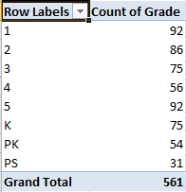
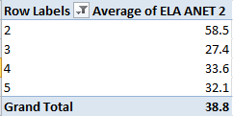
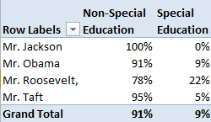
How do PivotTables Work?
Fundamentals Handout
Page 3
Spreadsheet of Data
Total Students per Grade
Average ANET Score
% SPED Students
Notes:
2 (10)

Slide 6
Creating PivotTables
Go to: http://bit.ly/ExcelClass
Open:
Sample Student Data Report.xlsx
Notes:
5 (15)

Slide 7
Creating PivotTables
We are now going to go to excel to learn how to create PivotTables.
You will learn how to:
Insert – See Page 4
Create – See Pages 5-6
Format – See Pages 7-8
Not covered, but in your packet:
Graph with PivotTables – See Pages 9-10
Notes:
30 (45)

Slide 8
Review
Take turns with your neighbor explaining how to create a PivotTable (1 minute each)
Notes:
5 (50)

Slide 9
Session Outcomes
By the end of this session, participants will be able to:
Articulate 2-3 types of analyses that can be completed using PivotTables
Use PivotTables to complete 2-3 types of analyses
Communicate the process of investigating priority questions using PivotTables
Notes:
1 (51)

Slide 10
Investigating Priority Questions
ALT reviews high level school data
ALT creates one or two priority questions
Investigate the question
Request additional data
Generate data-driven solutions
In many cases, this can be done by triangulating data with PivotTables
Questions Handout
Page 2
Notes:
2 (53)

Slide 11
Step 1 – Data Overview Meeting
90 - 120 minute leadership meeting dedicated to reviewing high-level data
Attendance
Behavior
Demographics
Performance
Enrollment
Notes:
2 (55)

Slide 12
Steps 2 and 3 – Flag concerns and Ask Priority Question
From the data overview, identify the areas you are most concerned about
Select one you are most interested in investigating
Write a question about the root causes of this area of concern.
One simple formats for this question is:
What (school/student/teacher) characteristics may be related to (area of concern)?
Notes:
2 (57)

Slide 13
Steps 4 and 5: Brainstorm Causes and Identify Data
Possible Cause or Factor
Data Point
Data Point
Possible Cause or Factor
Data Point
Data Point
Possible Cause or Factor
Data Point
Data Point
Notes:
2 (59)

Slide 14
Steps 6-8 – Data, Analysis, and Solutions
6. Generate Dataset
7. Triangulate with PivotTables
Data on Area of Concern | Data Point 1 | Data Point 2 | Data Point 3 | Data Point 3
Area of Concern
Data Point 1
ANALYSIS
Data Point 2
8. Formulate Data-driven Solutions
Notes:
1 (60)

Slide 15
Example – Priority Question Creation
1-2. After reviewing school data, the team decides to prioritize in-seat attendance, which was 90% last year
3. The team generates the following priority question:
4. The team brainstorms some demographic and classroom characteristics that may be affecting attendance:
What demographic and classroom characteristics may be related to attendance?
Teacher | Performance | Behavior | Prior Attendance
Gender | SPED Status | Address | Student Safety
Notes:
3 (63)

Slide 16
Example – Priority Question Analysis
5. We request and receive the following data set to investigate our question
Analysis with PivotTable shows significant gap by gender
Notes:
3 (66)

Slide 17
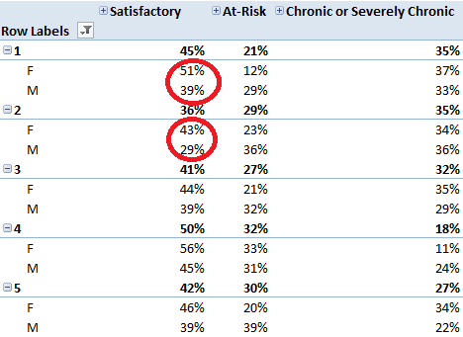
Example – Priority Question Analysis Deep Dive 1
Is this a problem across the school?
By adding grade to the PivotTable, I discover the gap is most pronounced in 1st and 2nd grade
Notes:
2 (68)

Slide 18
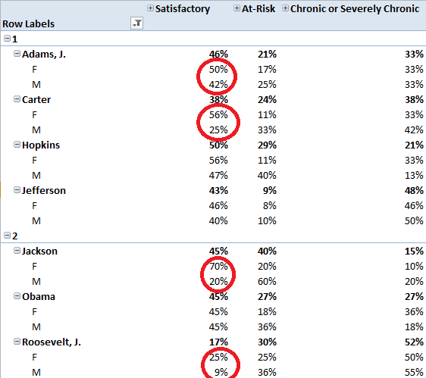
Example – Priority Question Analysis Deep Dive 2
Is this a problem in certain classrooms in those early grades?
Diving one step deeper, I find extremely large gaps in attendance by gender with four of my teachers
Next step: investigate through observations if there is a difference in how males are treated in those classes
Notes:
2 (70)

Slide 19
Investigating Priority Questions
ALT reviews high level school data
ALT creates one or two priority questions
Investigate the question
Request additional data
Generate data-driven solutions
Questions about this process?
Notes:
5 (75)

Slide 20
Practice – Your Turn to Investigate!
Go back to your data set
See if you can use PivotTables to investigate if any of the other characteristics may be related to attendance:
Suspensions
Prior attendance
Beginning of year reading level
Zip code
Special education status
Share what you find with your neighbors
Notes:
10 (85)

Slide 21
Review
Give a summary of the priority question investigation process to your neighbor
Notes:
2 (87)

Slide 22
Next Steps
Write down one strategy for how you will practice using PivotTables in the next week
Notes:
2 (89)

Slide 23
Contact Information
Jessica Joy Morris – jjmorrisdc@gmail.com
Feel free to email me if you have any excel questions!
Notes:
1 (90)

