Slide 1
Analyzing Student Work Over Time
July 2015

Slide 2
Session Outcomes
By the end of this session, participants will be able to:
Understand how to apply 2-3 tools for examining Performance Based Assessments (PBAs)
Identify at least 2 areas of student growth they can examine in PBAs over time
Develop a basic strategy for examining student work on performance tasks over time in the upcoming school year
Notes:
2

Slide 3
What is a Performance Based Assessment (PBA)?
In the context of PARCC, a PBA is a CCSS-aligned, evidence-based writing prompt based on content from one or more texts
Formulate Answer with Partner
Notes:
2 (4)

Slide 4
Key Question
What should teachers examine when looking at performance based assessments over time?
Formulate Answer with Partner
Notes:
4 (8)

Slide 5
Strategies for Looking at Student Work Over Time
Grade-level Expectations
Identify skills common across a variety of reading and writing standards
General Expectations
Score using the PARCC rubric
Notes:
2 (10)

Slide 6
Examining Student Writing with CCSS W.1 and W.2
Consider the expectations outlined in CCSS Writing Standards W.1 and W.2
How do these relate to the PARCC rubric?
What is the relationship between these standards and reading comprehension?
How do these expectations change from one grade to the next?
Handout
Page 2
Notes:
10 (20)

Slide 7
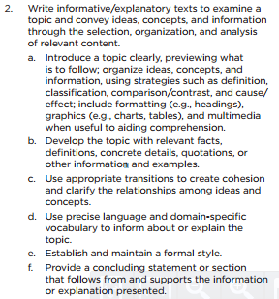
Writing Standards v. PARCC Rubric
7.W.2
Reading Comprehension
The student response demonstrates full comprehension of ideas stated explicitly and inferentially by providing an accurate analysis and supporting the analysis with effective and convincing textual evidence.
Written Expression
The student response addresses the prompt and provides effective and comprehensive development of the claim or topic that is consistently appropriate to the task by using clear and convincing reasoning supported by relevant textual evidence;
demonstrates purposeful coherence, clarity, and cohesion, making it easy to follow the writer’s progression of ideas;
establishes and maintains an effective style, attending to the norms and conventions of the discipline.
Notes:
3 (23)

Slide 8
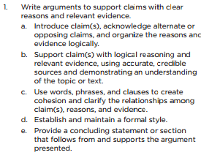
Argumentative Writing v. Expository Writing
7.W.1
7.W.2
Notes:
3 (26)

Slide 9
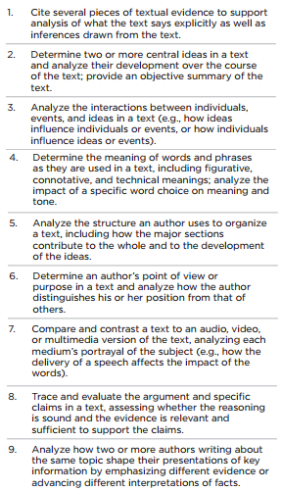
Writing v. reading standards
Writing
Reading
Evidence
Analysis
Language
Notes:
3 (29)

Slide 10
Assessing reading comprehension through writing
It is impossible for a student to fully meet the standards of a text and evidence-based writing piece without demonstrating significant reading comprehension skills
Notes:
1 (30)

Slide 11
Looking at Student PBA Writing Over Time
Strategy
Monitor mastery of key skills embedded in the first two writing standards
Compare progress on skills to overall PARCC rubric scores
Handout
Page 4
Notes:
3 (33)

Slide 12
Things to consider when looking at PBAs over time
Comprehension and performance may vary according to text and task complexity
Objective is to see if students are growing in ability to:
leverage text based evidence
communicate ideas in a clear, cohesive, grade-level appropriate way
consistently adapt analysis and writing skills to a variety of tasks over time
Text-based Evidence
Clear, Cohesive Ideas
Adaptation to Task
Notes:
2 (35)

Slide 13
Practice: Examining student work over time
Samples are from a DCPS Middle School 7th Grade ELA class
Expository prompt on Jewish Ghettos during WWII (September 2014 )
Expository prompt comparing and contrasting two literary texts on the values of mothers (November 2014)
Argumentative prompt on youth engaging in dangerous sporting activities to set records (January 2015)
Notes:
2 (37)

Slide 14
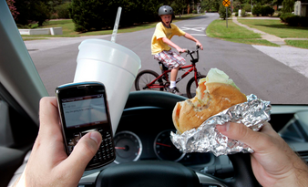
FOCUS
The Goal of this Activity IS
Evaluate student progress toward developing grade-level writing skills to communicate, analyze, and apply text based evidence
The Goal of this Activity IS NOT
Evaluate the quality / appropriateness of the prompts / texts
Avoid distracted analyzing!
Notes:
2 (40)

Slide 15
The Rule of 5
Academic Leadership Team
The Rationale:
Deep analysis of all student responses, especially with multiple classes, is generally not feasible
Deep analysis of a small sample can provide valuable insights on instruction
The Process:
Quickly scan the student work
Find 5 students who look like they are across the spectrum in their performance
Use sample to determine next steps
Low Response
it's the way she walked (wow) Straight into my heart and stole it. Through the doors and past the guards (wow), Just like she already owned it. I said, "Can you give it back to me?" She said,
Lower Response
it's the way she walked (wow) Straight into my heart and stole it. Through the doors and past the guards (wow), Just like she already owned it. I said, "Can you give it back to me?" She said, "Never in your wildest dreams." And we danced all night to the
Middle Response
it's the way she walked (wow) Straight into my heart and stole it. Through the doors and past the guards (wow), Just like she already owned it. I said, "Can you give it back to me?" She said, "Never in your wildest dreams." And we danced all night to the best song ever. We knew every line. Now I can't remember How it goes but I know that I won't forget her 'Cause we danced all night to the best song ever. I think it went oh, oh, oh I think it went
High Response
it's the way she walked (wow) Straight into my heart and stole it. Through the doors and past the guards (wow), Just like she already owned it. I said, "Can you give it back to me?" She said, "Never in your wildest dreams." And we danced all night to the best song ever. We knew every line. Now I can't remember How it goes but I know that I won't forget her 'Cause we danced all night to the best song ever. I think it went oh, oh, oh I think it went yeah, yeah, yeah I think it goes oh Said her name was Georgia Rose (wow), And her daddy was a dentist. Said I had a dirty mouth (I got a dirty mouth) But she kissed me like she meant it. I said, "Can I take you home with me?" She said, "Never in your wildest dreams." And we danced all night to the best song ever. We knew every line. Now I can't remember How it goes but I know that I won't forget her 'Cause we danced all night to the best song ever. I think it went oh, oh, oh I think it went yeah, yeah, yeah I think it goes oh
Very High Response
it's the way she walked (wow) Straight into my heart and stole it. Through the doors and past the guards (wow), Just like she already owned it. I said, "Can you give it back to me?" She said, "Never in your wildest How it goes but I know that I won't forget her 'Cause we danced all night to the best song ever. I think it went oh, oh, oh I think it went yeah, yeah, yeah I think it goes oh Said her name was Georgia Rose (wow), And her daddy was a dentist. Said I had a dirty mouth (I got a dirty mouth) But she kissed me like she meant it. I said, "Can I take you home with me?" She said, "Never in your wildest dreams." And we danced all night to the best song ever. We knew every line. Now I can't remember How it goes but I know that I won't forget her 'Cause we danced all night to the best song ever. I think it went oh, oh, oh I think it went yeah, yeah, yeah I think it goes oh
Notes:
5 – ask if anyone has done this. Discuss why it is effective. (45)

Slide 16
Two Strategies for Approaching Analysis Over Time
Go through prompts one-by-one
Go through students one-by-one
For each prompt:
Read the texts and prompt
Go through each student response one-by-one
Jot notes on ways in which student is or is not meeting each part of the standard
After reviewing each text and prompts:
For each student, go through each response one-by-one
Jot notes on ways in which student is or is not meeting each part of the standard
Identify where the student has or has not shown improvement
Analyze Individually
Compare Notes
Notes:
45 (1 hr 15)

Slide 17
Example Analysis
Notes:
5 (1 hr 20)

Slide 18
Analyzing progress
Go back through your notes
Highlight improvements in student performance in green
Highlight stagnation in student performance in yellow
Highlight declines in student performance in red
Analyze Individually
Compare Notes
Notes:
10 (1 hour 30)

Slide 19
Evaluate Instruction
Based on this sample of students, what can you conclude about:
What evidence to do you see of this class growing toward grade-level writing expectations?
What evidence is there of students adapting writing and analytical skills to a variety of tasks?
What are your concerns about student development over this time period?
What questions does this raise about what was happening in the classroom?
Formulate Answer with Partner
Notes:
15 (1 hour 45)

Slide 20
Action Planning
If you were this teacher, what might you do next with this information?
Consider :
Short/Long-term Goals
Students
Curriculum
Instruction
Group Discussion
Notes:
10 (1 hour 55)

Slide 21
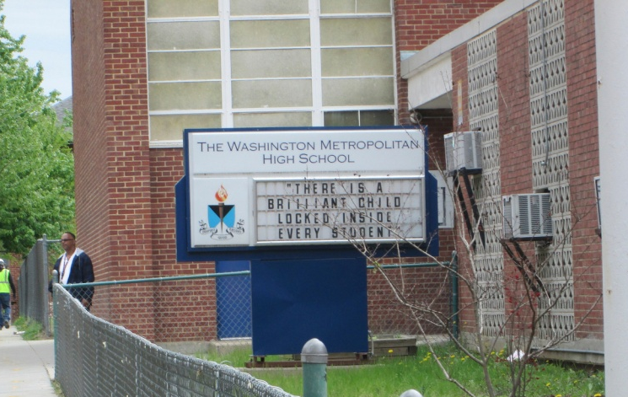
School-based Example: Washington Met
Introduced a school-wide writing program in SY14-15 that focused on cohesive one-paragraph prompts
BOY, MOY, EOY
All students in the school completed a one hour ELA assessment in whatever class they were in during the scheduled time
ELA teachers scored the assignments and entered score into common tracking spreadsheet
Monthly
Science, Social Studies, Math, and ELA teachers gave content specific writing assignments
Scored on a common rubric for writing; subject-area rubrics for content
Grade level data meetings
Reviewed progress student writing across content areas by grade level
Notes:
5 (2 hours)

Slide 22
School-based Example: Washington Met
Successes
Involved non-ELA teachers in developing student written communication
Previewed writing rubric with the whole school
Got buy-in by supporting teachers uncomfortable with writing their own prompts
Successfully grew the skill of writing effective paragraphs across the student body
Lessons Learned
Plan monthly prompts earlier in the school year
Ensure prompts are text-dependent
Schedule monthly action planning meetings
Create binders to collect student work in each grade level
Notes:
2 (2 hours 2)

Slide 23
Adding a cycle of reviewing PBAs over time
What trends could you look at?
What would you need to do to evaluate those trends?
Assessments
Tracking Documents
Student portfolios
Time to review, plan response, and conference with students
Now Plan!
Notes:
15 (2 hours 17)

Slide 24
Resources for Responding to Student Writing
Achieve the Core Writing Lessons – http://achievethecore.org/page/711/sample-writing-task
In Common Writing Samples (Vermont Writing Collaborative) – http://achievethecore.org/page/507/in-common-effective-writing-for-all-students
Writing Revolution (Hochman Writing) – http://www.thewritingrevolution.org
PARCC Question stems (if you don’t already have them)
Notes:
30 (2 hours 50)

Slide 25
Contact Information
Jessica Joy Morris – jjmorrisdc@gmail.com
Feel free to email me if you have any questions or to share strategies you employ for look at ELA PBAs over time!
Notes:
5 (3 hours)

