Slide 1
Understanding RIT and Reading MAP Reports

Slide 2
Agenda
Unique features of the RIT scale
Calibrating items for MAP
Scoring a test
Interpretation of scores
How to read the MAP teacher report
How to group students based on MAP reports

Slide 3
One Size Fits All

Slide 4
MAP/MPG Platform
MAP/MPG are computerized adaptive tests (CATs), which means that each student receives a test that is tailored to his/her level of achievement.
The RIT scale is the platform upon which:
New items are calibrated
Test items are chosen for a student
A student’s score is computed and interpreted

Slide 5
Item calibration
Item calibration is the process by which we figure out how difficult an item is.
Calibration based on item response theory—specifically, the Rasch model.
Specifies the relationship between a student’s achievement level and his/her chances of getting an item correct.

Slide 6
A Basic Math Item…5X5=
Notes:
Students with a RIT of 150 are only 20% likely to answer this question correctly, whereas students at a 230 RIT are 90—100% likely to answer this question correctly.

Slide 7
Item Difficulty: the RIT value at which we expect half of the students to pass the item.
Notes:
When we field test an item, we look at the final RIT scores for all students who answered the item. Higher scoring kids typically get the answer correct most of the time, and lowering scorings kids are less likely to correctly answer.

Slide 8
Problematic Items
Notes:
Because 50% of students, regardless of their RIT score did not get this question correct, it is likely that there is a flaw in the question itself.

Slide 9
The Item Bank
Once an item has been calibrated, it (along with its difficulty) is added to the item bank.
Item bank contain thousands of test items.
Large item banks are essential for using a computer adaptive test (CAT).
Once a student sees an item, he won’t see that item again for 14 months

Slide 10
Figuring out which items to give
So, if we know a student’s actual achievement level, we just give items matched to that student’s achievement level.
But, wait! If we knew the student’s achievement level, we wouldn’t need to test.
The test must first figure out where the student is on the RIT scale, and then give more items there.
This is what happens during a CAT.

Slide 11
How does a CAT work?
Pick an item of appropriate starting difficulty.
The item is presented & answered by the student.
If answer is right, choose a harder item to give next. If answer is wrong, choose an easier item to give next.
Repeat steps 2 & 3, focusing on items that maximize the information gathered, until enough items have been given (more items, greater precision…to a point).
Calculate the student’s RIT score.

Slide 12
Interpreting a RIT score
How is a student’s RIT score interpreted?
A spring RIT score in math of, say 240, by itself is not interpretable.
We need to have one or more reference points to interpret a score.

Slide 13
Percent vs. Percentile
Percent-number of questions answered correctly out of the total number of questions
Percentile-A percentile ranking represents how well a student performs compared to other students in a nationwide norm sample for their grade. A student scoring at the 35th percentile scored as well as, or better than, 35 percent of students in the same grade in the norm group. It also means that 65 percent of the students exceeded this score.
Notes:
A common mistake is for people to think this means that the student got 35 percent of the items correct. Percentile is not related to the percent of correct answers a student gets on a test.
The percentile is not a good method for measuring growth in students. Students who achieve typical growth will remain at approximately the same percentile score over time.

Slide 14
Student Achievement Status

Slide 15
Student Growth

Slide 16
Content-How to use MAP to inform instruction

Slide 17
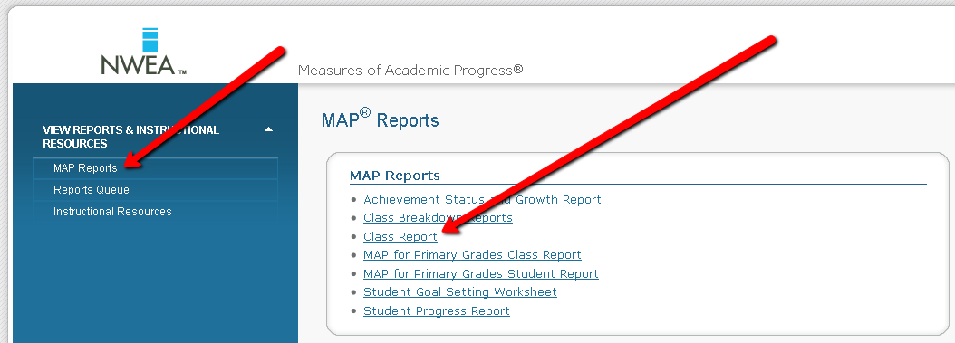

Slide 18
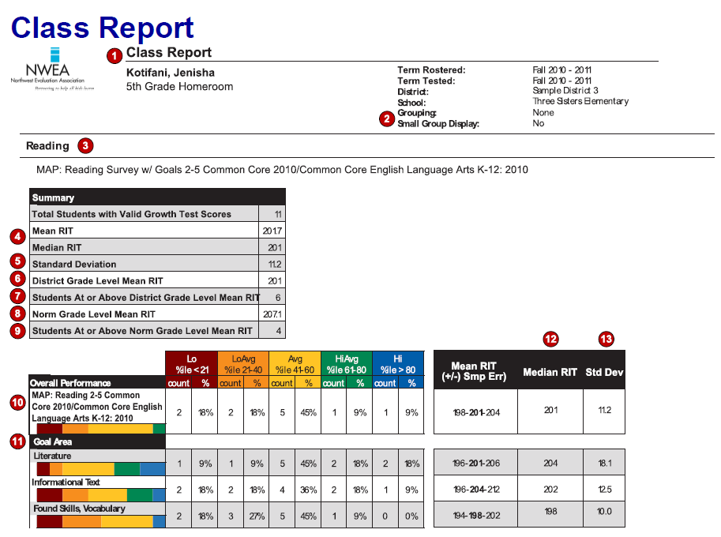

Slide 19
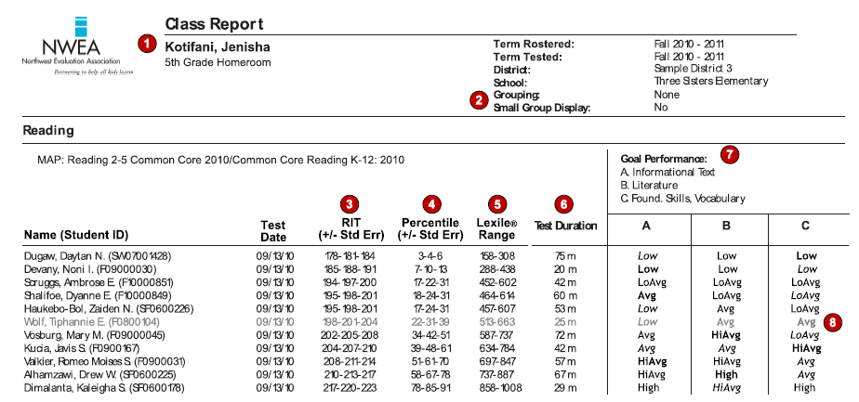

Slide 20
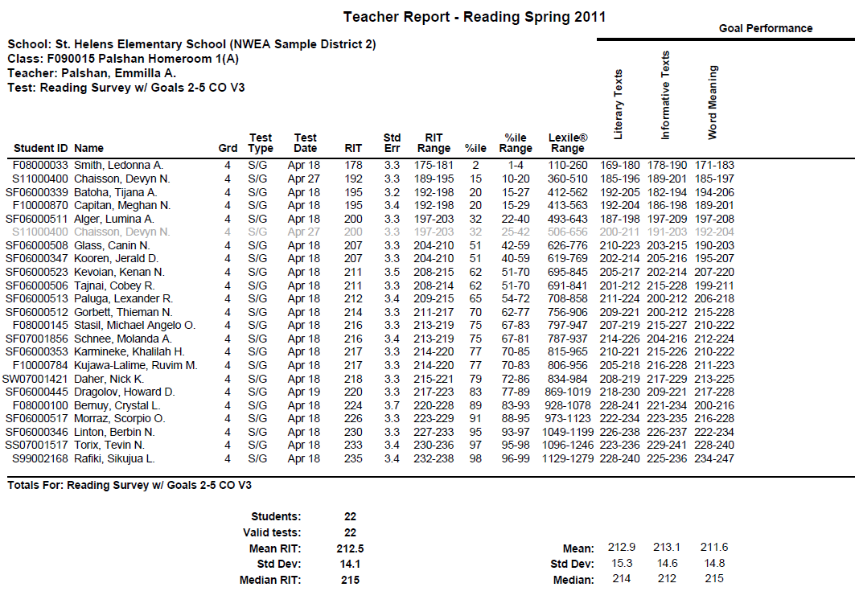
[teacher report]
Notes:
Focus on Reading Teacher Report (Sample from 08 NWEA website to protect student privacy).
Goals may be different b/c they are reflective of the state that is tested. Format is the same.
What makes the Reading report slightly different than the Math/Language Usage reports? (Lexile Range)
Given in RIT RANGES for goal areas, but can also be reported in the High, Average, Low. (SHOW SAMPLE) WHY WOULD THAT BE HELPFUL?! (Differentiated Instruction or Flexible Grouping)

