Slide 2
Visualizing Data and Communicating Information
Larry Jerome: Data Architect
KIPP DC

Slide 3
Introductions
Name
Organization/Role
Most commonly used platform (e.g. excel, R, Tableau, etc. )
What are you currently working on or what’s currently challenging you?
Notes:
What are you currently working on? Use this for activity 1

Slide 4
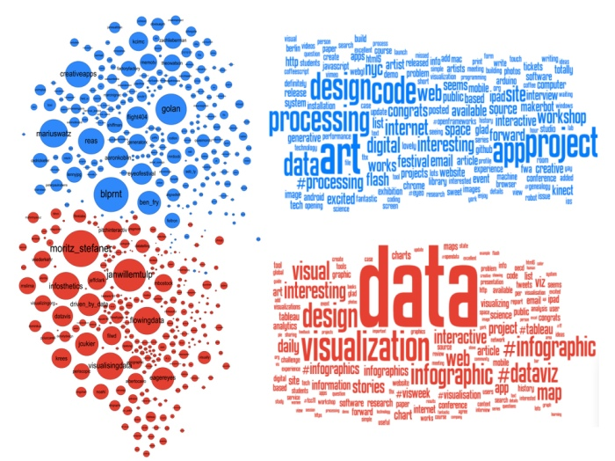
What is data visualization?
Notes:
Add picture

Slide 5
What is data visualization?
A primary goal of data visualization is to communicate information clearly and efficiently to users graphics, plots, information graphics, tables, and charts
Source: Wikipedia; Jen Underwood: Business Intelligence and Predictive Analytics, April 10, 2013
Notes:
Source: Jen Underwood Business Intelligence and Predictive Analytics at Impact Analytix, April 10, 2013

Slide 6
What is data visualization?
Two basic types of visualization
Exploratory
Explanatory
Source: Wikipedia; Jen Underwood: Business Intelligence and Predictive Analytics, April 10, 2013
Notes:
Source: Jen Underwood Business Intelligence and Predictive Analytics at Impact Analytix, April 10, 2013
Exploratory for live reporting-attendance, also grades
Explanatory for period reporting-End of window test scores, grades

Slide 7
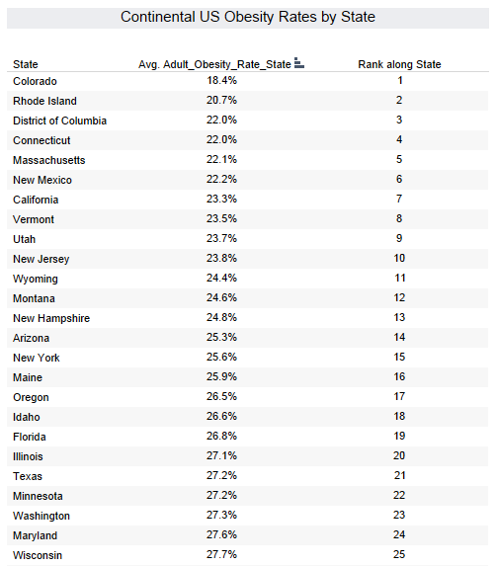
Why We Visualize
Notes:
What insights can be easily drawn from this table?

Slide 8
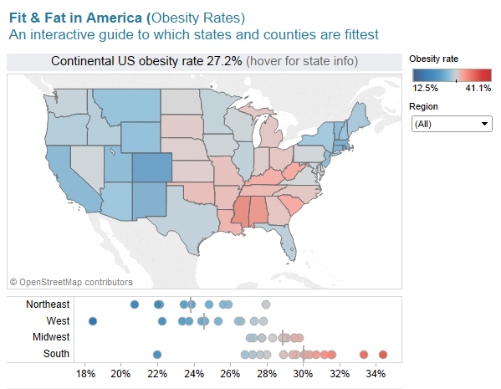
Why We Visualize
Notes:
What insights can be easily drawn from this visualization?

Slide 9
Process Of Developing Visualizations
Identify your purpose
Quantify it
Visualize it

Slide 10
Identifying Your Purpose
What questions do you need to answer?
Who is your audience?
What questions do they have?
What action will be taken?
Source: Rebecca Vichniac: KIPP Data Summit, June 2014
Notes:
Audience:
Role: what decisions do they make? What questions do they need answered?
work flow: in what context will it be used? What information is needed regularly? How much time do they have?
Comfort and skills: how sophisticated are they with using the data? Do they enjoy digging into the numbers?
Business and data expertise: How familiar are they with the metrics? Do they understand where the data comes from? Are they familiar with the organization and terminology?
The special ed team wants to close the achievement gap between special ed and gen ed students. How can you help inform their decision making and planning?
How can we use blended learning platforms effectively?

Slide 11
Identifying Your Purpose: Who is your audience
Role: what decisions do they make? What questions do they need answered?
Work flow: in what context will it be used? What information is needed regularly? How much time do they have?
Comfort and skills: how sophisticated are they with using the data? Do they enjoy digging into the numbers?
Business and data expertise: How familiar are they with the metrics? Do they understand where the data comes from? Are they familiar with the organization and terminology?
Source: Rebecca Vichniac: KIPP Data Summit, June 2014
Notes:
Audience:
Role: what decisions do they make? What questions do they need answered?
work flow: in what context will it be used? What information is needed regularly? How much time do they have?
Comfort and skills: how sophisticated are they with using the data? Do they enjoy digging into the numbers?
Business and data expertise: How familiar are they with the metrics? Do they understand where the data comes from? Are they familiar with the organization and terminology?
The special ed team wants to close the achievement gap between special ed and gen ed students. How can you help inform their decision making and planning?
How can we use blended learning platforms effectively?

Slide 12
Activity 1: Identifying Your Purpose

Slide 13
Choosing The Right Metrics
Notes:
What are some examples of metrics you use? Why do you use them?

Slide 14
Choosing The Right Metrics: What Is A Metric?
Notes:
What are some examples of metrics you use? Why do you use them?

Slide 15
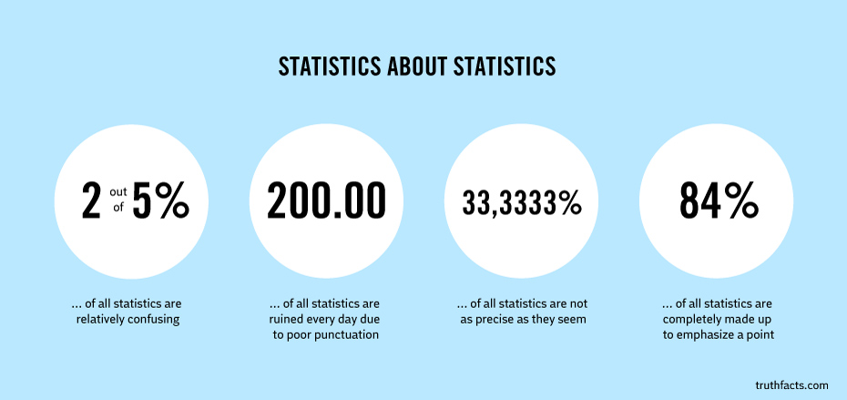
Choosing The Right Metrics: What Is A Metric?
Notes:
What are some examples of metrics you use? Why do you use them?

Slide 16
Choosing the right metric
The Perfect Metric
Actionable
Transparent & Simple Calculation
Accessible & Accurate Data
Common Interpretation
Actionable
Align to organizational mission or strategy
Identify specific, quantifiable outputs/outcomes
Establish targets against which results can be evaluated
Notes:
3 bullet points focus on actionability

Slide 17
Choosing The Right Metric: Evaluating Metrics
What are the limitations of this metric?
Is there any analysis to show that these are the right metrics?
Do these metrics change depending on the audience?
Source: Rebecca Vichniac: KIPP Data Summit, June 2014

Slide 18
Activity 2: Quantify It

Slide 19
Choosing The Right Chart Type
Comparison
Composition
Relationship
Distribution

Slide 20
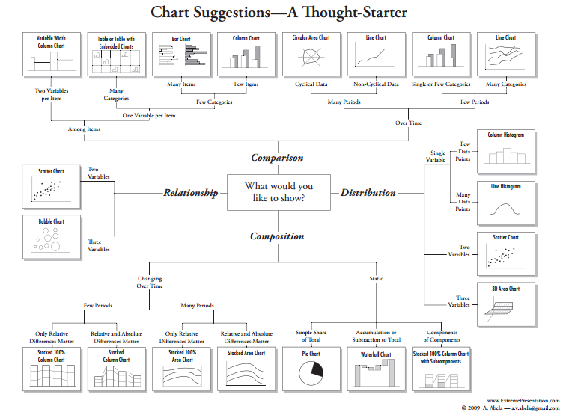
Choosing The Right Chart Type

Slide 21
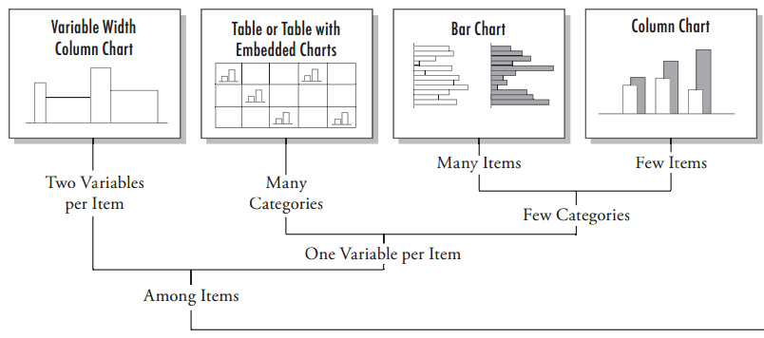
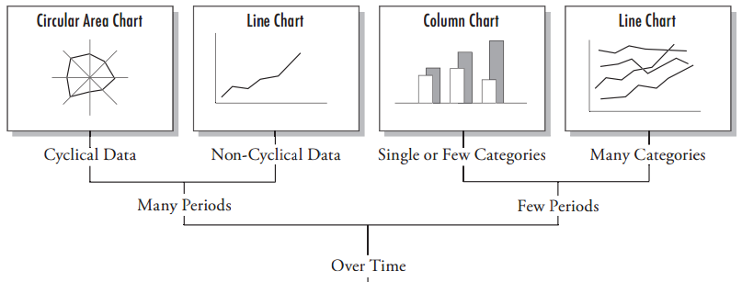
Choosing The Right Chart Type: Comparison
Among Items
Over Time
Notes:
Among items:
Bars and columns are the best: encodes quantitative values as length on the same baseline
Two variables per item: use color gradient instead of width when possible-width can distort height comparison and people are good at distinguishing colors
Bar charts, when ranking should be in order
Do no overlap bars
Over time
Time should generally be on the X axis especially if there are many periods
Cyclical data can sometimes be more effectively shown on a line chart
Use line chart to show and compare trends of categories within a dimension
Use a bar chart to compare in time periods
http://www.tableausoftware.com/sites/default/files/media/whitepaper_visual-analysis-guidebook.pdf
Dimensions= attributes of the data (term, grade, quartiles)

Slide 22
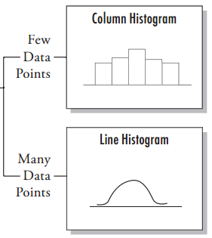
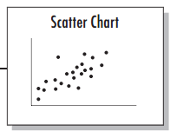
Choosing The Right Chart Type: Distribution
Single Variable
Two (or more) Variables
Notes:
Show the distribution of values per interval
Can also use a box plot to show the changes in distribution over time interval or dimension categories
-highlights values not apparent on histograms
Counts of the values per interval from lowest to highest
Show the distribution of a single measure
Box plot (box and whisker plot)
Useful for showing multiple distributions
Easily identify important data points
Show how a distribution has changed over time
Histogram
Useful for showing data with unusual distributions
Show distributions at a higher level of detail
Show the distribution of multiple measures
Scatterplot
Similar to correlation chart

Slide 23
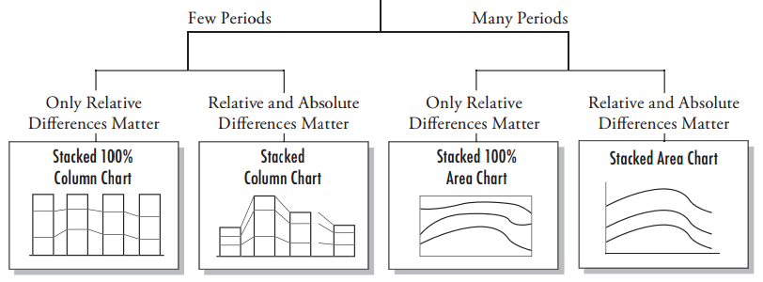
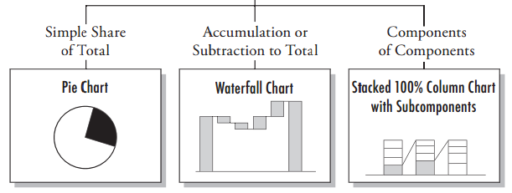
Choosing The Right Chart Type: Composition
Changing over time
Static
Notes:
Values represent parts (proportions) of a whole.
Many period=continuous data
Few periods=discrete data
Stacked bar charts highlight the pattern over time intervals
Components of components: stacked bar male vs female sped and not sped
Vertical bars only!

Slide 24
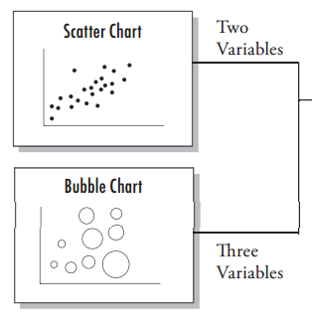
Choosing the right chart type: Relationship
Comparison of two or more sets of values
Notes:
Running a simple correlation analysis can help identify relationships between measures, but remember that correlation doesn’t guarantee a relationship.
Scatterplots
Typically used to show the relationship between 2 variables
Using color and size to show 3 and 4 dimensions
Parallel line chart
Compare the changes in slope and value of related measures
Bar charts
May be used when the audience is not familiar with scatterplots

Slide 25
Enhancing Visualizations
Color Hue
Color Saturation
Size
Notes:
Emphasize the most important idea
put the most important data on the X- or Y-axis and less important data on the color, size or shape.
Physical position in the easiest to perceive and the most powerful visual property (start at the top left)
Orient your views for legibility
If you have a view that only has long labels that only fit vertically, try rotating the view.
Make it easy to compare values, especially when differences in values are small
-Encode quantitative data accurately
Choose the proper axis
keep them consistent across views
axis of different lengths can exaggerate slope
choose the right context (length of time)
keep intervals consistent
Using consistent color gradients
Avoid overloading your views
Too much information can obscure the point
Instead of stacking many measures and dimensions into one condensed view, break them down into small multiples
Use text sparingly
Do not use 3-D views
Avoid noisy fill patterns, line styles, or saturated/bright colors, and borders (except for highlighting values)
Limit the number tick marks

Slide 26
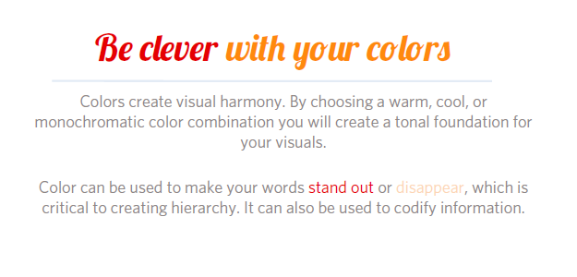
Enhancing Visualizations
Notes:
Emphasize the most important idea
put the most important data on the X- or Y-axis and less important data on the color, size or shape.
Physical position in the easiest to perceive and the most powerful visual property (start at the top left)
Orient your views for legibility
If you have a view that only has long labels that only fit vertically, try rotating the view.
Make it easy to compare values, especially when differences in values are small
-Encode quantitative data accurately
Choose the proper axis
keep them consistent across views
axis of different lengths can exaggerate slope
choose the right context (length of time)
keep intervals consistent
Using consistent color gradients
Avoid overloading your views
Too much information can obscure the point
Instead of stacking many measures and dimensions into one condensed view, break them down into small multiples
Use text sparingly
Do not use 3-D views
Avoid noisy fill patterns, line styles, or saturated/bright colors, and borders (except for highlighting values)
Limit the number tick marks

Slide 27
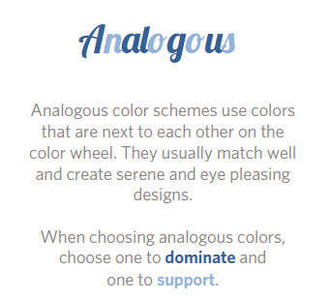
Enhancing Visualizations
Notes:
Use analogous colors for ordinal or interval values (continuous)
Use complimentary colors for nominal values, and comparisons (discrete)
Emphasize the most important idea
put the most important data on the X- or Y-axis and less important data on the color, size or shape.
Physical position in the easiest to perceive and the most powerful visual property (start at the top left)
Orient your views for legibility
If you have a view that only has long labels that only fit vertically, try rotating the view.
Make it easy to compare values, especially when differences in values are small
-Encode quantitative data accurately
Choose the proper axis
keep them consistent across views
axis of different lengths can exaggerate slope
choose the right context (length of time)
keep intervals consistent
Using consistent color gradients
Avoid overloading your views
Too much information can obscure the point
Instead of stacking many measures and dimensions into one condensed view, break them down into small multiples
Use text sparingly
Do not use 3-D views
Avoid noisy fill patterns, line styles, or saturated/bright colors, and borders (except for highlighting values)
Limit the number tick marks

Slide 28
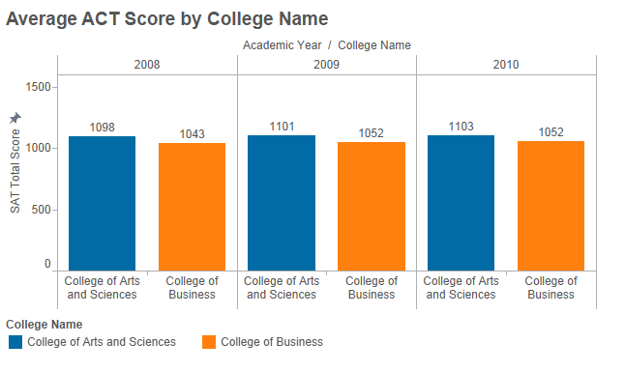
Enhancing Visualizations
Use Complimentary Colors for Comparisons
Notes:
Emphasize the most important idea
put the most important data on the X- or Y-axis and less important data on the color, size or shape.
Physical position in the easiest to perceive and the most powerful visual property (start at the top left)
Orient your views for legibility
If you have a view that only has long labels that only fit vertically, try rotating the view.
Make it easy to compare values, especially when differences in values are small
-Encode quantitative data accurately
Choose the proper axis
keep them consistent across views
axis of different lengths can exaggerate slope
choose the right context (length of time)
keep intervals consistent
Using consistent color gradients
Avoid overloading your views
Too much information can obscure the point
Instead of stacking many measures and dimensions into one condensed view, break them down into small multiples
Use text sparingly
Do not use 3-D views
Avoid noisy fill patterns, line styles, or saturated/bright colors, and borders (except for highlighting values)
Limit the number tick marks

Slide 29
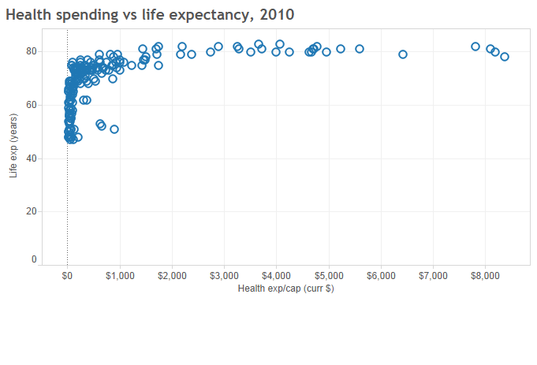
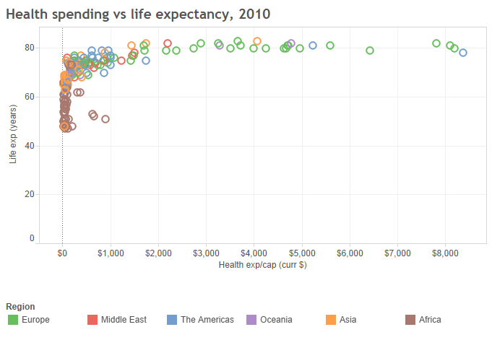
Enhancing Visualizations
Identify Groups of Attributes
Use fewer than 6 colors
Notes:
Emphasize the most important idea
put the most important data on the X- or Y-axis and less important data on the color, size or shape.
Physical position in the easiest to perceive and the most powerful visual property (start at the top left)
Orient your views for legibility
If you have a view that only has long labels that only fit vertically, try rotating the view.
Make it easy to compare values, especially when differences in values are small
-Encode quantitative data accurately
Choose the proper axis
keep them consistent across views
axis of different lengths can exaggerate slope
choose the right context (length of time)
keep intervals consistent
Using consistent color gradients
Avoid overloading your views
Too much information can obscure the point
Instead of stacking many measures and dimensions into one condensed view, break them down into small multiples
Use text sparingly
Do not use 3-D views
Avoid noisy fill patterns, line styles, or saturated/bright colors, and borders (except for highlighting values)
Limit the number tick marks

Slide 30
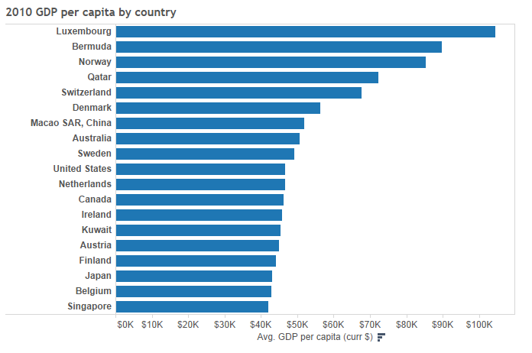
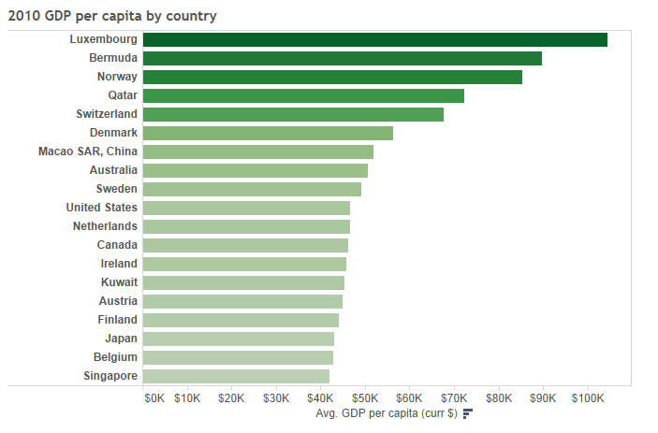
Enhancing Visualizations
Highlight Metric Patterns
Less saturation: small values
More saturation: larger values
Notes:
Emphasize the most important idea
put the most important data on the X- or Y-axis and less important data on the color, size or shape.
Physical position in the easiest to perceive and the most powerful visual property (start at the top left)
Orient your views for legibility
If you have a view that only has long labels that only fit vertically, try rotating the view.
Make it easy to compare values, especially when differences in values are small
-Encode quantitative data accurately
Choose the proper axis
keep them consistent across views
axis of different lengths can exaggerate slope
choose the right context (length of time)
keep intervals consistent
Using consistent color gradients
Avoid overloading your views
Too much information can obscure the point
Instead of stacking many measures and dimensions into one condensed view, break them down into small multiples
Use text sparingly
Do not use 3-D views
Avoid noisy fill patterns, line styles, or saturated/bright colors, and borders (except for highlighting values)
Limit the number tick marks

Slide 31
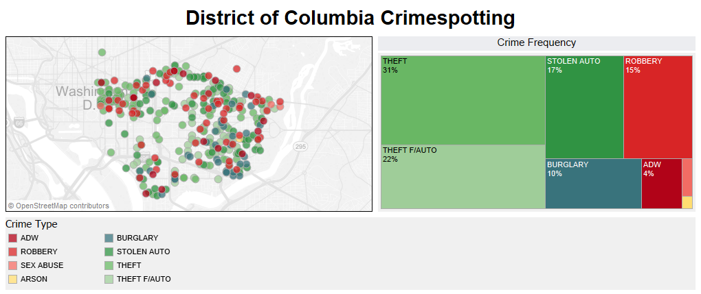
Enhancing Visualizations: Color Saturation
Add Size to Emphasize Metric Trends
Notes:
Emphasize the most important idea
put the most important data on the X- or Y-axis and less important data on the color, size or shape.
Physical position in the easiest to perceive and the most powerful visual property (start at the top left)
Orient your views for legibility
If you have a view that only has long labels that only fit vertically, try rotating the view.
Make it easy to compare values, especially when differences in values are small
-Encode quantitative data accurately
Choose the proper axis
keep them consistent across views
axis of different lengths can exaggerate slope
choose the right context (length of time)
keep intervals consistent
Using consistent color gradients
Avoid overloading your views
Too much information can obscure the point
Instead of stacking many measures and dimensions into one condensed view, break them down into small multiples
Use text sparingly
Do not use 3-D views
Avoid noisy fill patterns, line styles, or saturated/bright colors, and borders (except for highlighting values)
Limit the number tick marks

Slide 32
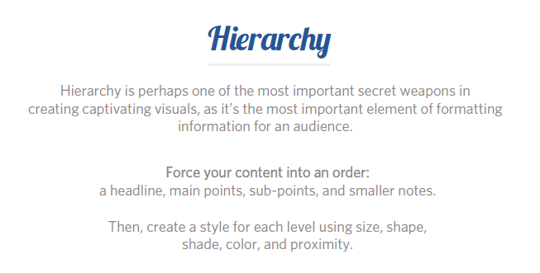
Enhancing Visualizations
Notes:
Emphasize the most important idea
put the most important data on the X- or Y-axis and less important data on the color, size or shape.
Physical position in the easiest to perceive and the most powerful visual property (start at the top left)
Orient your views for legibility
If you have a view that only has long labels that only fit vertically, try rotating the view.
Make it easy to compare values, especially when differences in values are small
-Encode quantitative data accurately
Choose the proper axis
keep them consistent across views
axis of different lengths can exaggerate slope
choose the right context (length of time)
keep intervals consistent
Using consistent color gradients
Avoid overloading your views
Too much information can obscure the point
Instead of stacking many measures and dimensions into one condensed view, break them down into small multiples
Use text sparingly
Do not use 3-D views
Avoid noisy fill patterns, line styles, or saturated/bright colors, and borders (except for highlighting values)
Limit the number tick marks

Slide 33
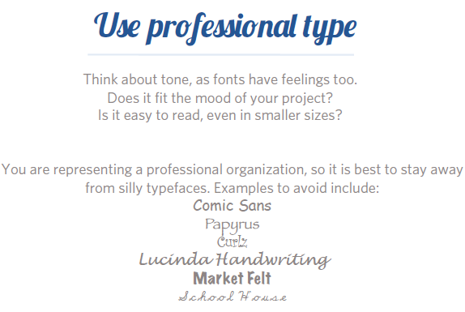
Enhancing Visualizations
Notes:
Emphasize the most important idea
put the most important data on the X- or Y-axis and less important data on the color, size or shape.
Physical position in the easiest to perceive and the most powerful visual property (start at the top left)
Orient your views for legibility
If you have a view that only has long labels that only fit vertically, try rotating the view.
Make it easy to compare values, especially when differences in values are small
-Encode quantitative data accurately
Choose the proper axis
keep them consistent across views
axis of different lengths can exaggerate slope
choose the right context (length of time)
keep intervals consistent
Using consistent color gradients
Avoid overloading your views
Too much information can obscure the point
Instead of stacking many measures and dimensions into one condensed view, break them down into small multiples
Use text sparingly
Do not use 3-D views
Avoid noisy fill patterns, line styles, or saturated/bright colors, and borders (except for highlighting values)
Limit the number tick marks

Slide 34
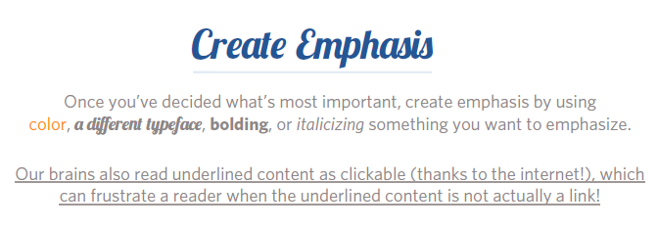
Enhancing Visualizations
Notes:
Emphasize the most important idea
put the most important data on the X- or Y-axis and less important data on the color, size or shape.
Physical position in the easiest to perceive and the most powerful visual property (start at the top left)
Orient your views for legibility
If you have a view that only has long labels that only fit vertically, try rotating the view.
Make it easy to compare values, especially when differences in values are small
-Encode quantitative data accurately
Choose the proper axis
keep them consistent across views
axis of different lengths can exaggerate slope
choose the right context (length of time)
keep intervals consistent
Using consistent color gradients
Avoid overloading your views
Too much information can obscure the point
Instead of stacking many measures and dimensions into one condensed view, break them down into small multiples
Use text sparingly
Do not use 3-D views
Avoid noisy fill patterns, line styles, or saturated/bright colors, and borders (except for highlighting values)
Limit the number tick marks

Slide 35
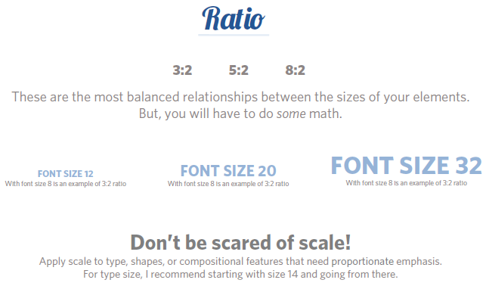
Enhancing Visualizations
Notes:
Emphasize the most important idea
put the most important data on the X- or Y-axis and less important data on the color, size or shape.
Physical position in the easiest to perceive and the most powerful visual property (start at the top left)
Orient your views for legibility
If you have a view that only has long labels that only fit vertically, try rotating the view.
Make it easy to compare values, especially when differences in values are small
-Encode quantitative data accurately
Choose the proper axis
keep them consistent across views
axis of different lengths can exaggerate slope
choose the right context (length of time)
keep intervals consistent
Using consistent color gradients
Avoid overloading your views
Too much information can obscure the point
Instead of stacking many measures and dimensions into one condensed view, break them down into small multiples
Use text sparingly
Do not use 3-D views
Avoid noisy fill patterns, line styles, or saturated/bright colors, and borders (except for highlighting values)
Limit the number tick marks

Slide 36
Activity 3: Visualize It

Slide 37
Best in Data Visualization
https://public.tableau.com/s/gallery
Filter to education
Explore

